Slide 1
H. James Norton, www.jimnortonphd.com William E. Anderson T-Test

Slide 2
Student’s t-test
Who was Student
& what was his occupation?

Slide 3
William Gosset
1876 - 1937
Chief Brewer at Guinness Brewery

Slide 4
Scenario for T-test
Comparing 2 groups where outcome is on interval scale:
H_{0:} μ₁ = μ₂ (population means of 2 groups are equal)
H_{1:} μ₁ ≠ μ₂ (population means of 2 groups are not equal)
Statistical test employed is Student’s t-test.
Example: Outcome variable is systolic blood pressure after 6 months of treatment. Patients randomized to diuretic or new drug.

Slide 5
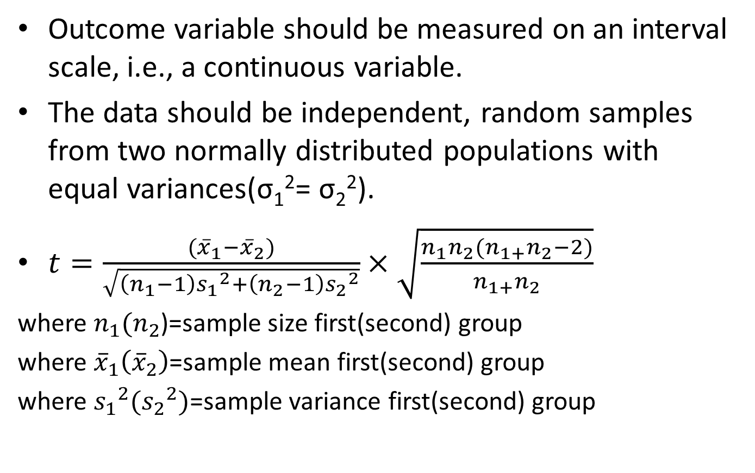
Assumptions of t-test
Outcome variable should be measured on an interval scale, i.e., a continuous variable.
The data should be independent, random samples from two normally distributed populations with equal variances(σ₁²= σ₂²).
$t=\frac{({\overline{x}}_{1}−{\overline{x}}_{2})}{\sqrt{\left(n_{1}−1\right){s_{1}}^{2}+\left(n_{2}−1\right){s_{2}}^{2}}}×\sqrt{\frac{n_{1}n_{2}(n_{1+}n_{2}−2)}{n_{1+}n_{2}}}$
where ${n_{1}(n}_{2}$)=sample size first(second) group
where ${\overline{x}}_{1}\left({\overline{x}}_{2}\right)$=sample mean first(second) group
where ${s_{1}}^{2}({s_{2}}^{2})$=sample variance first(second) group

Slide 6
What if the assumptions for t-test are not met?
If the data are normally distributed but do not have equal variances, SAS uses Satterthwaite’s adjustment for unequal variances.
If the data are not normally distributed one can:
a) Try to transform the data, e.g., take the logarithm or square root. If the transformed variable is normally distributed then do a t-test.
b) Do a non-parametric test such as the Wilcoxon rank sum test that does not assume normality.

Slide 7
Systolic Blood Pressure-Males vs Females
Data:
Females | Males
120 | 148
132 | 137
145 | 165
118 | 142
127 | 138
124 | 143
139 | -
125 | -
Label | N | Mean | Std Dev | Variance | Std. Error
Females | 8 | 128.75 | 9.3465 | 87.3571 | 3.30449
Males | 6 | 145.5 | 10.3296 | 106.700 | 4.21703

Slide 8
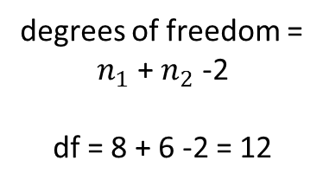
$$t=\frac{(128.75−145.50)}{\sqrt{\left(7\right)\left(87.36\right)+(5)(106.7)}}×\sqrt{\frac{\left(8\right)(6)(12)}{14} }=−3.18$$
Summary Statistics:
gender | N | Mean | Std Dev | Std Err | Minimum | Maximum
F | 8 | 128.8 | 9.3465 | 3.3045 | 118.0 | 145.0
M | 6 | 145.5 | 10.3296 | 4.2170 | 137.0 | 165.0
Diff (1-2) |  | -16.7500 | 9.7681 | 5.2754
degrees of freedom =
$n_{1}$ + $n_{2}$ -2
df = 8 + 6 -2 = 12
gender | Method | Mean | 95% CL Mean |  | Std Dev | 95% CL Std Dev
F |  | 128.8 | 120.9 | 136.6 | 9.3465 | 6.1797 | 19.0227
M |  | 145.5 | 134.7 | 156.3 | 10.3296 | 6.4478 | 25.3344
Diff (1-2) | Pooled | -16.7500 | -28.2441 | -5.2559 | 9.7681 | 7.0046 | 16.1246
Diff (1-2) | Satterthwaite | -16.7500 | -28.6461 | -4.8539
Method | Variances | DF | t Value | Pr > |t|
Pooled | Equal | 12 | -3.18 | 0.0080
Satterthwaite | Unequal | 10.262 | -3.13 | 0.0104
Equality of Variances
Method | Num DF | Den DF | F Value | Pr > F
Folded F | 5 | 7 | 1.22 | 0.7798

Slide 9
Paired T-Test
Test hypothesis H₀ : μ_{d}=0
Assumptions: A random sample of n paired differences from a normally distributed population of differences
Test Statistic : $t=\frac{\overline{d}}{\frac{s_{d}}{\sqrt{n}}}$
Distribution of test statistic when H₀ is true: Student’s t distribution with n-1 degrees of freedom.
( where n = # of pairs of observations)

Slide 10
Example:
A pharmaceutical company is engaged in preliminary investigation of a new drug which may have serum cholesterol-lowering properties. A small study is designed using 6 subjects. Serum cholesterol determination in milligrams per 100 milliliters are made before and after treatment on each subject
Reference: Remington RD, Schork MA, Statistics with Applications to the Biological and Health Sciences,179,214. New Jersey: Prentice-Hall, 1970.
Subject Number | 1 | 2 | 3 | 4 | 5 | 6
Cholesterol level before treatment(x_{1j}) | 217 | 252 | 229 | 200 | 209 | 213
Cholestrol level after treatment(x_{2j}) | 209 | 241 | 230 | 208 | 206 | 211
Difference(d_{j}=x_{1j} – x_{2j}) | 8 | 11 | -1 | -8 | 3 | 2

Slide 11
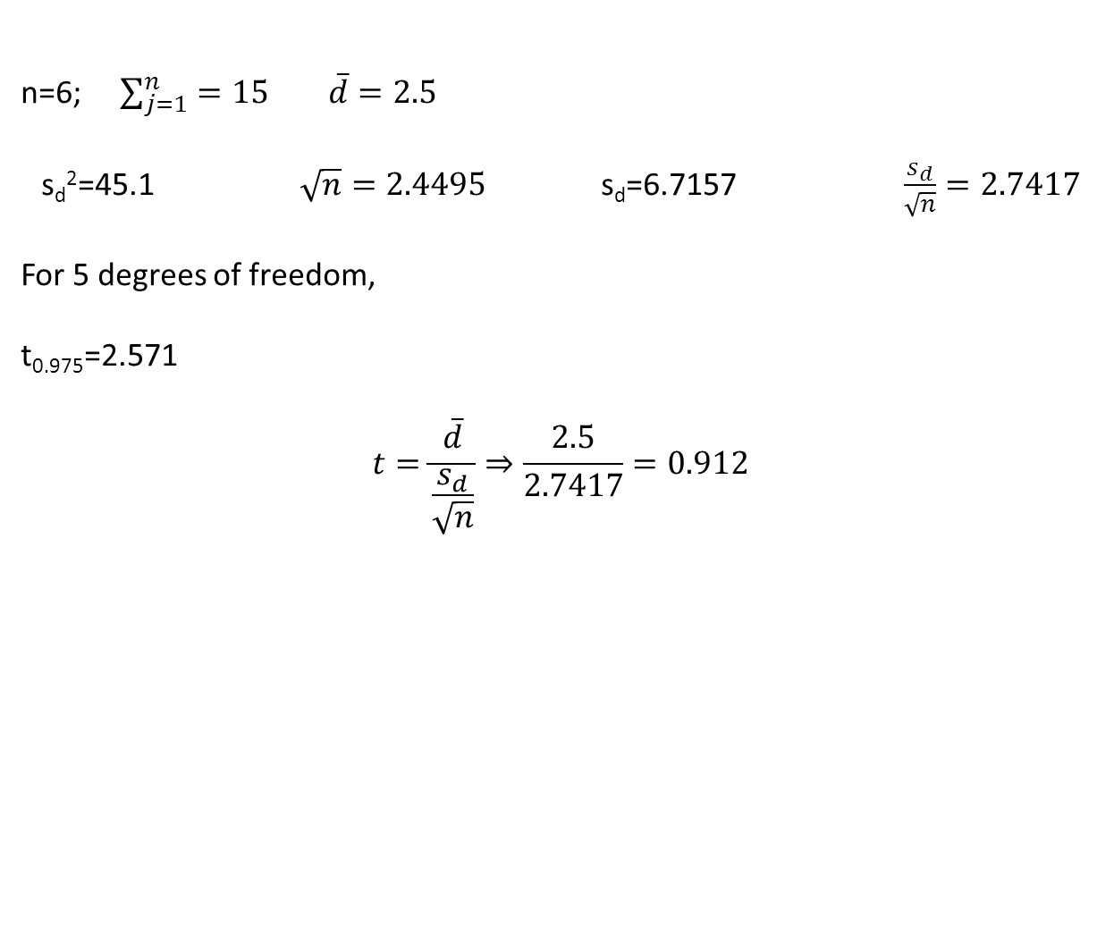
n=6; $\sum_{j=1}^{n}{=15 \overline{d}=2.5 }$
s_{d}²=45.1 $\sqrt{n}=2.4495$ s_{d}=6.7157 $\frac{s_{d}}{\sqrt{n}}=2.7417$
For 5 degrees of freedom,
t_{0.975}=2.571
$$t=\frac{\overline{d}}{\frac{s_{d}}{\sqrt{n}}}⇒\frac{2.5}{2.7417}=0.912$$
N | Mean | Std Dev | Std Err | Minimum | Maximum
6 | 2.5000 | 6.7157 | 2.7417 | -8.0000 | 11.0000
Mean | 95% CL Mean |  | Std Dev | 95% CL Std Dev
2.5000 | -4.5476 | 9.5476 | 6.7157 | 4.1920 | 16.4709
DF | t Value | Pr > |t|
5 | 0.91 | 0.4037

Slide 12
Suppose we want to compare two diets to lower cholesterol. From the literature (or a preliminary study) we learn that a standard deviation (σ) of 30 mg/dl is a reasonable assumption. Suppose we decide a clinically significant difference (δ) is 20 mg/dl.
What sample size is required for a t-test with an α=0.05 and a power of 0.8?
For independent t-tests approximately $n=\frac{{(z_{α}+z_{β})}^{2}×2σ^{2}}{δ^{2}}$
n for each group, 2n for whole study
Then σ=30 , δ=20
(z_{α}+z_{β})² is read off table below
Power | Two Tailed Test
 | α Level
 | 0.01 | 0.05 | 0.10
0.80 | 11.7 | 7.9 | 6.2
0.90 | 14.9 | 10.5 | 8.6
0.95 | 17.8 | 13.0 | 10.8

Slide 13
$n=7.9×2×\frac{{30}^{2}}{{20}^{2}}⇒35.55 or 36 needed$ In each group (total experiment =72 patients)
From: *Statistical Methods by Snedecor & Cochran, 6th Edition, Iowa State Univ. Press,
Iowa 1978

