Slide 1
Jeopardy
The Category is : Statistics
(but you don’t have to be a statistician to answer questions about statistics!)
H. James Norton
Website: www.jimnortonphd.com

Slide 2

Jeopardy for 100
She said, “And may the odds ever be in your favor?
Who is Effie Trinket in the Hunger Games?

Slide 3
Statistics for 200
She said, “ I am fain to sum up an urgent appeal for adopting a uniform system of publishing the statistical records of hospitals. In attempting to arrive at the truth, I have applied everywhere for information, but scarcely have I been able to obtain hospital records fit for any purpose of comparison.”

Slide 4
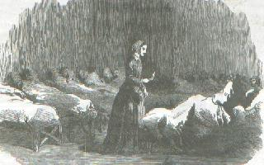
Who is Florence Nightingale?
Lady with the Lamp

Slide 5

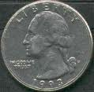
Statistics for 250
This famous owner (now deceased) of a US sports team said, “Everybody knows it’s always heads.”

Slide 6

Who is George Steinbrenner?
Owner New York Yankees
(1930 – 2010)
Al Rosen had to call the flip of a coin for home-field advantage
for a playoff game in 1978. He said: “George, we lost the toss.
We’re going to Boston.” Steinbrenner said:
“What!? What did you call?” I said, “Tails.” That set him off.
“Everybody knows it’s always heads!”

Slide 7
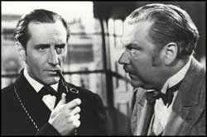
Statistics for 300
He said, “Data! Data! Data!
I cannot make bricks without clay.”
Who is Sherlock Holmes?

Slide 8
Statistics for 350
It was said of him ,
“He is endowed with a phenomenal mathematical faculty. At the age of 21 he wrote a treatise upon the binomial theorem. He won a mathematical chair at one of our smaller universities. … But the man had hereditary tendencies of the most
diabolical kind.”
(Hint: The answer is related to the previous answer for 300)

Slide 9
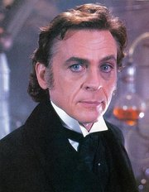
Who is Professor Moriarty?
From : The Naval Treaty: in
The Memoirs of Sherlock Holmes

Slide 10
Statistics for 400
He said, “ I am not a statistician.
I am not a predictor.”

Slide 11
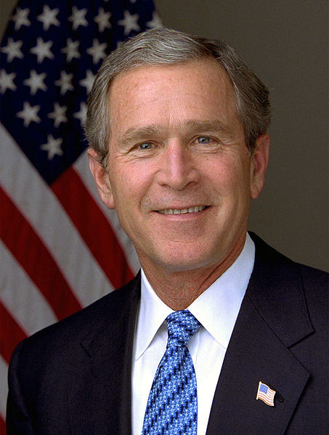
Who is George W. Bush?

Slide 12
He was responding to :
“The White House backed away Wednesday from its own prediction that the economy will add 2.6 million new jobs before the end of the year, saying that the forecast was the work of number-crunchers.”

Slide 13

Jeopardy for 450
“An utterly steady, reliable woman, responsible to the point of grimness.
Daisy was a statistician for the Gallup Poll.” Daisy was his first wife.
Who is Herzog? ( in Herzog by Saul Bellow)

Slide 14
Statistics for 500
The 2 substances R.A. Fisher combines
in his famous “thought experiment”
in Chapter One of
The Design of Experiments (1935).

Slide 15
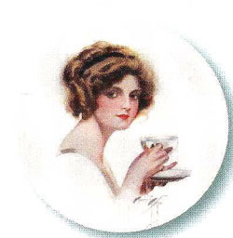
What are milk and tea?
In “The Mathematics of a Lady Tasting Tea” Fisher describes a hypothetical lady who claims she can discriminate whether the
milk was added to the tea or whether the
tea was added to the milk. He designs an experiment & statistical analysis to test her claim.

Slide 16
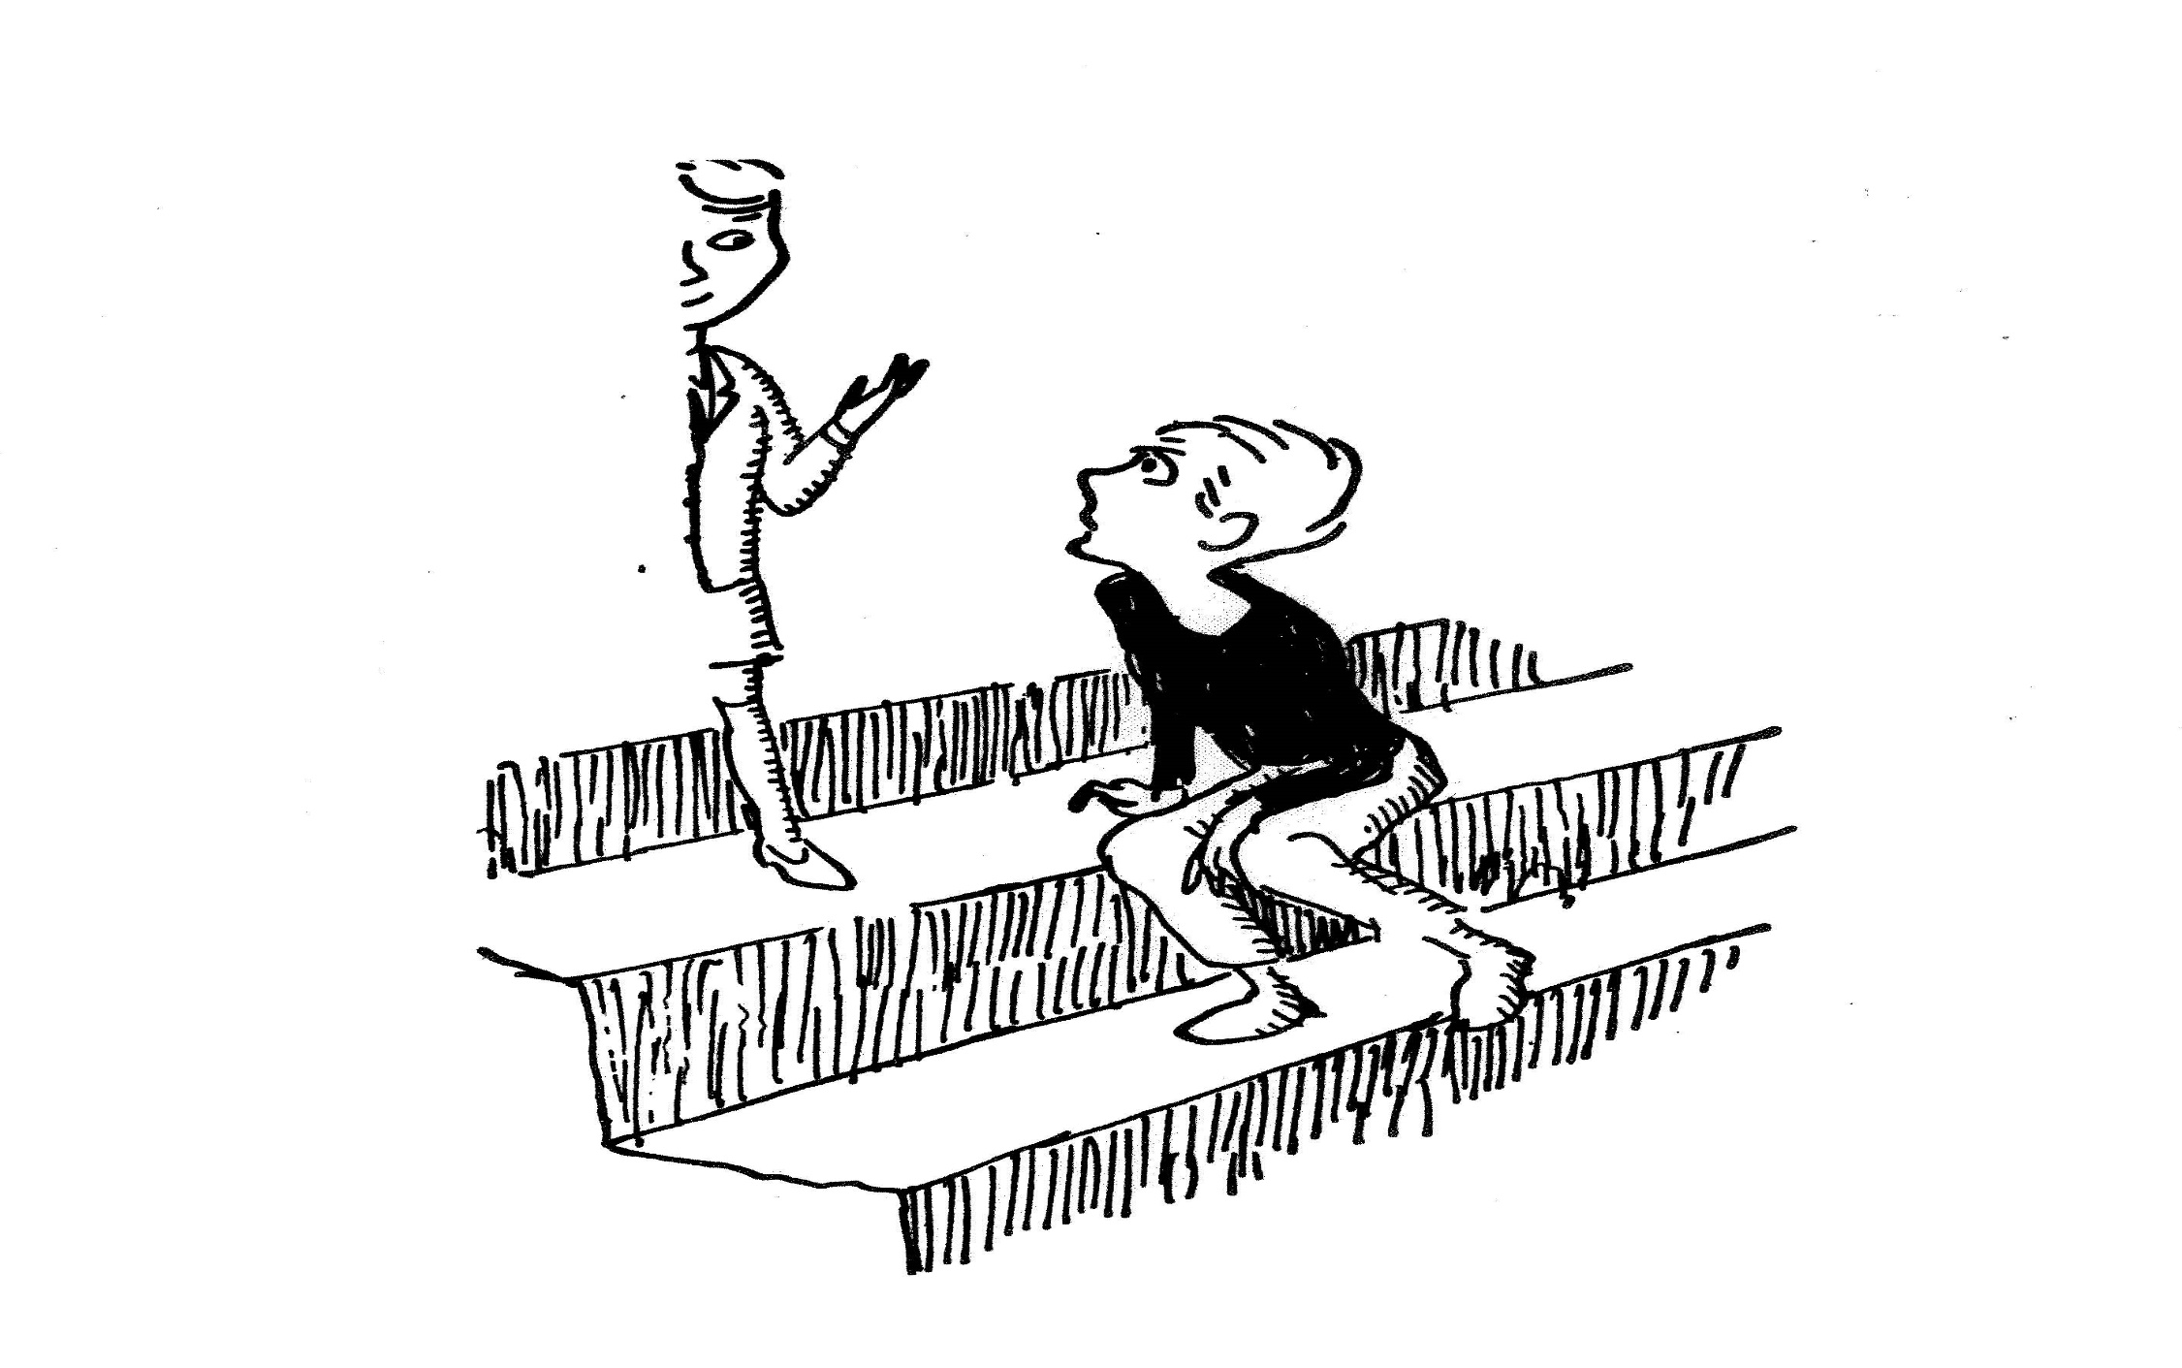

Statistics for 600
The book this picture is from:

Slide 17
What is the Phantom Tollboth by Norton Juster
Illustrations by Jules Feiffer?
Milo said “I’ve never seen half a child before”.
“It’s .58” said the child. “It’s a bit more than a half.”
“What is the rest of your family like?” asked Milo.
“We’re just the average family, mother, father, and 2.58 children. I’m the .58”.
… “Besides, each family has 1.3 automobiles, and since I’m the only one who can drive three tenths of a car, I get to use it all the time”.

Slide 18
“But averages aren’t real,” objected Milo; “they’re just imaginary.”
“That may be so,” he agreed, “but there also very useful at times. For instance , if you didn’t have any money at all, but you happened to be with four other people who had $10 apiece, then you’d each have an average of $8. Isn’t that right?”
“I guess so,” said Milo weakly.
“Well, think how much better off you’d be just because of averages,” he explained convincingly.

Slide 19
Statistics for 650
In 1897 this famous US Supreme Court justice said,
“For the rational study of the law the black letter man may be the man of the present, but the man of the future is the man of statistics and the master of economics.”

Slide 20
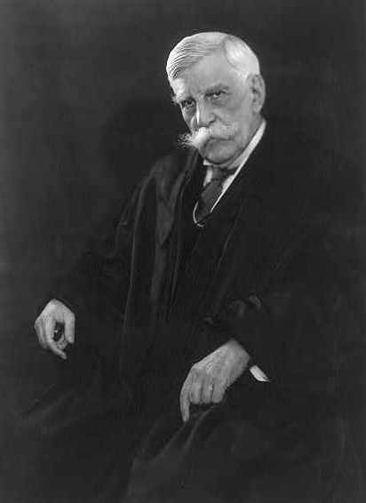
Who is Oliver Wendell Holmes, Jr.?

Slide 21
Statistics for 700
The book this is a quote from:
“Grown-ups love figures. When you tell them you have made a new friend, they never ask you about essential matters. They never ask you, “What games does he love best? …Instead they demand, “How old is he? How much money does his father make?” Only from these figures do they think they have learned anything about him.”

Slide 22
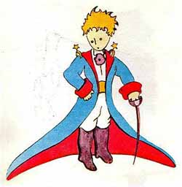
What is “The Little Prince?”

Slide 23
Statistics for 800
The book this is a quote from:
“I found myself in a hole nine fathoms under the grass. …Looking down, I observed that I had on a pair of boots with exceptionally sturdy straps. Grasping them firmly, I pulled with all of my might. Soon I had hoist myself to the top and stepped out on terra firma without further ado.”

Slide 24
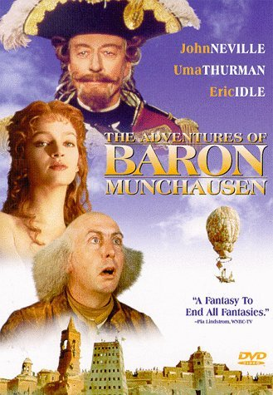
What is the Singular Travels, Campaigns
and Adventures of Baron Munchausen?

Slide 25
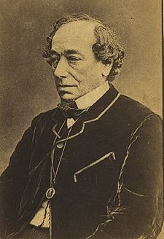
Jeopardy for 900
He said,
“There are
LIES,
DAMN LIES,
& STATISTICS!”
Who is Benjamin Disraeli?
Prime Minister England
(1868, 1874-1880)?

Slide 26
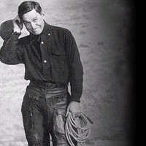
Jeopardy for 1000
In addition to his comment on the Okies moving from Oklahoma to California,
he also said, “We are always reading statistics and figures. Half of America do nothing but prepare statistics for the other half to read.” But I am sure he meant it in a good way.

Slide 27
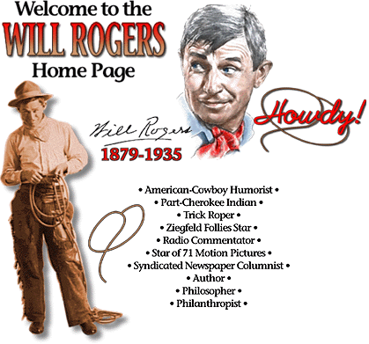
http://www.willrogers.org/
Who is Will Rogers?

Slide 28
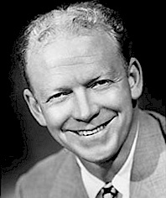
Jeopardy for 1100
Will the panelists arm themselves with encyclopedias and fact books?
“Not really.” said this famous sportscaster. “I probably will carry two or three record books. I would imagine, though , that my main contribution would be my memory of events and people. I think the dullest thing you can get into is statistics.
Who is Red Barber?
From an article by Barry Cooper, Tallahassee Democrat, July 31, 1981. [Cooper quoted the legendary baseball announcer Red Barber about his role in an upcoming National Public Radio call-in show called, “ The Great Trivia Baseball Game. “The show was designed to relieve baseball-starved fans during the 1981 strike by major league baseball players.]

Slide 29
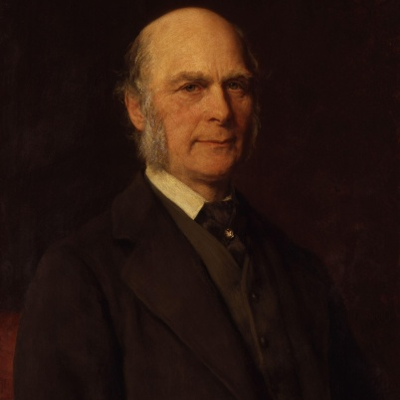
Jeopardy for 1200
In addition to writing “Regression towards mediocrity in heredity stature”,
he also said, “Whenever you can, count.”
Who is Sir Francis Galton (1822-1911)?

Slide 30
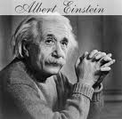
Jeopardy for 1300
He said, “Not everything that can be counted counts,
and not everything that counts can be counted.”
Who is Albert Einstein?

Slide 31
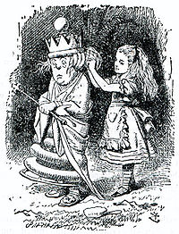
Jeopardy for 1400
She said “Can you do Addition? What are one and one and one and one and one and one and one and one and one and one?”
Who is the White Queen?
“I don’t know” said Alice, “I lost count.”
She can’t do Addition”, The Red Queen interrupted.
Alice “a-dressing the White Queen”
Through the Looking Glass by Lewis Carroll
Art by John Tenniel (1865)

Slide 32
Statistics for 1450
The test that should be performed to answer:
“The general problem may be stated as follows: having given the number of instances in which things are both thus and so, in which they are thus but not so, in which they are so but not thus, and in which they are neither thus nor so, it is required …to determine the quantitative relativity between the thusness and the soness of the things.”

Slide 33
What is the chi-square test?
From:
Bulletin of
the Philosophical
Society of Washington, (1888).
 | Thus | Not Thus
So
Not So

Slide 34
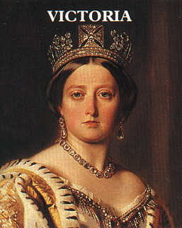
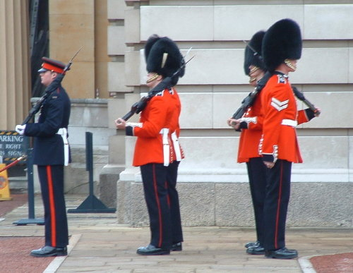
Jeopardy for
Jeopardy for 1500
He said, “If Experimentation is the Queen of the Sciences,
surely Statistical Methods must be regarded as
the Guardian of the Royal Virtue.
Who is Myron Tribus?
Director of Advanced Engineering Study at MIT (from a letter to Science)

Slide 35

Jeopardy for 1600
Aaron Levenstein compared statistics to this type of women’s apparel.
What is a bikini?
“Statistics are like a bikini.
What they reveal is suggestive,
But what they conceal is vital.”

Slide 36
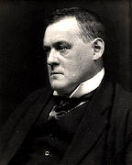


Jeopardy for 1700
He said,
Statistics are the triumph of the quantitative method, and the quantitative method is the victory of sterility and death.
Before the curse of statistics fell upon mankind we lived a happy, innocent life,
full of merriment and go and informed by fairly good judgment.
Before Statistics After Statistics
Who is Hilaire Belloc?
British Writer & Poet
(1870 – 1953)

Slide 37
Jeopardy for 1800
“Daniel’s a statistician. He sees numbers—fractions, equations, totals –and they spell out the odds for him. God knows he brilliant at it; he’s saved the lives of hundreds with those statistics.” from the Parsifal Mosaic
He is the author.
Who is Robert Ludlum?
(He also wrote The Bourne Identity)

Slide 38
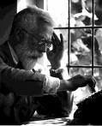
Jeopardy for 1900
He said, “That’s not an experiment you have there, that’s an experience .”
&
“To call in the statistician after the experiment is done may be no more than asking him to perform a postmortem examination: he may be able to say what the experiment died of. Indian Statistical Congress (ca. 1938)”
Who is Sir Ronald Aylmer Fisher?
(1890-1962)

Slide 39

Jeopardy for 2000
In 2009 he said, “The sexy job of the next 10 years will be statisticians.”
Who is Hal Varian, the chief economist at Google?

Slide 40
Jeopardy for 2100
He wrote the poem:
Thou shalt not do as the dean pleases,
Thou shalt not write thy doctor's thesis
On education.
Thou shalt not worship projects nor
Shalt thou or thine bow down before
Administration.
Thou shalt not answer questionnaires
Or quizzes upon world affairs,
Nor with compliance
Take any test. Thou shalt not sit
With statisticians nor commit
A social science.
Thou shalt not be on friendly terms
With guys in advertising firms,
Nor speak with such
As read the Bible for prose,
Nor, above all, make love to those
Who wash too much.
Thou shall not live within thy means
Nor on plain water and raw greens.
If thou must choose
Between the chances, choose the odd;
Read the New Yorker, trust in God,
And take short views.
Who is WH Auden?
(1907- 1973)

Slide 41
Jeopardy for 2500
He is the author of the short story “The Undoing of Lamia Gurdleneck”. This is a quote from the story: Aunt Sara said, “To express anything important in mere figures is so plainly impossible that there must be endless scope for well-paid advice on how to do it. But don’t you think that life with a statistician would be rather, shall we say, humdrum?” Lamia was silent. She felt reluctant to discuss the surprising depth of emotional possibility which she had discovered below Edward’s numerical veneer.
“It’s not the figures themselves,” she said finally, “it’s what you do with them that matters.”
Who is K.A.C. Manderville?
Maurice G. Kendall & Alan Stuart
ascribe the story to K.A.C. Manderville. However, this is a hoax. They invented both the quotation and the short story. In fact an anagram of Maurice G Kendall is Lamia Gurdleneck.

Slide 42
Jeopardy for 3000
He is the author of the short story, “The Handbook of Hymen.”
This is a summary of the story.
Sanderson Pratt and his partner, Idaho Green, were prospecting
in the Bitter Root Mountains of Montana. A terrible snowstorm
descends upon them. They gather all their possessions and a
huge pile of firewood into an abandoned cabin on the top of a hill.
After three weeks of being snowed in, they tire of each other’s
stories, cooking and companionship. They divide the cabin
and their possessions, including food, in half and stop talking
to each other.
Idaho happens to find two books on the top of a very tall shelf.
He decides it would only be fair if they played cards to determine
who would get first choice of the books. He wins the game and
as his book takes, “The Rubaiyat”. It is a book of Persian poems
(A jug of wine, a loaf of bread, and thou) by Omar Khayyam.

Slide 43
By default, Pratt is left with, “Herkimer’s Handbook of
Indispensable Information.” A few days later, Sandy describes
to Idaho what is contained in the book.
“What you’ve got, says Idaho, “is statistics, the lowest grade of information that exists. They’ll poison your mind.” …
After the snow finally melts, the two men strike it rich. They cash
in the gold and head to the small town of Rosa. They both decide
to woo the most eligible woman in town, the widow Mrs. Sampson.
They each decide to use the information from the book they have
read and memorized to impress Mrs. Sampson. Mrs. Sampson is
not impressed with the poetry that Idaho recites to her.
Later in the story Sandy tries to charm and impress Mrs. Sampson
with his knowledge of statistics.

Slide 44
“Let us sit on this log at the roadside,” says I, “and forget the inhumanity and ribaldry of the poets. It is in the glorious columns of ascertained facts and legalized measures that beauty is to be found. In this very log we sit upon, Mrs. Sampson,” says I, “is statistics more wonderful than any poem. The rings show it was sixty years old. At the depth of two thousand feet it would become coal in three thousand years. The deepest coal mine in the world is at Killingworth, near Newcastle. A box four feet long, three feet wide and two feet eight inches deep will hold one ton of coal. If an artery is cut, compress it above the wound. A man’s leg contains thirty bones. The Tower of London was burned in 1841”*.
“Go on, Mr. Pratt,” says Mrs. Sampson. “Them ideas is so original and soothing. I think statistics are just as lovely as they can be.”
*Knowledge gained from: Herkimer’s Handbook of Indispensable Information
Who is William Sydney Porter?
(1862 – 1910)
a.k.a. O. Henry

