Slide 1
Importance of a random sample:
An in-class demonstration

Slide 2
This demonstration was presented at JSM a number
of years ago. Does anyone know who gave this
demonstration so that we can give the proper credit?
The goal of the demonstration is to teach students
the importance of a random sample and a method
(using random number tables) to achieve such a sample.
Hand each student the following page.

Slide 3
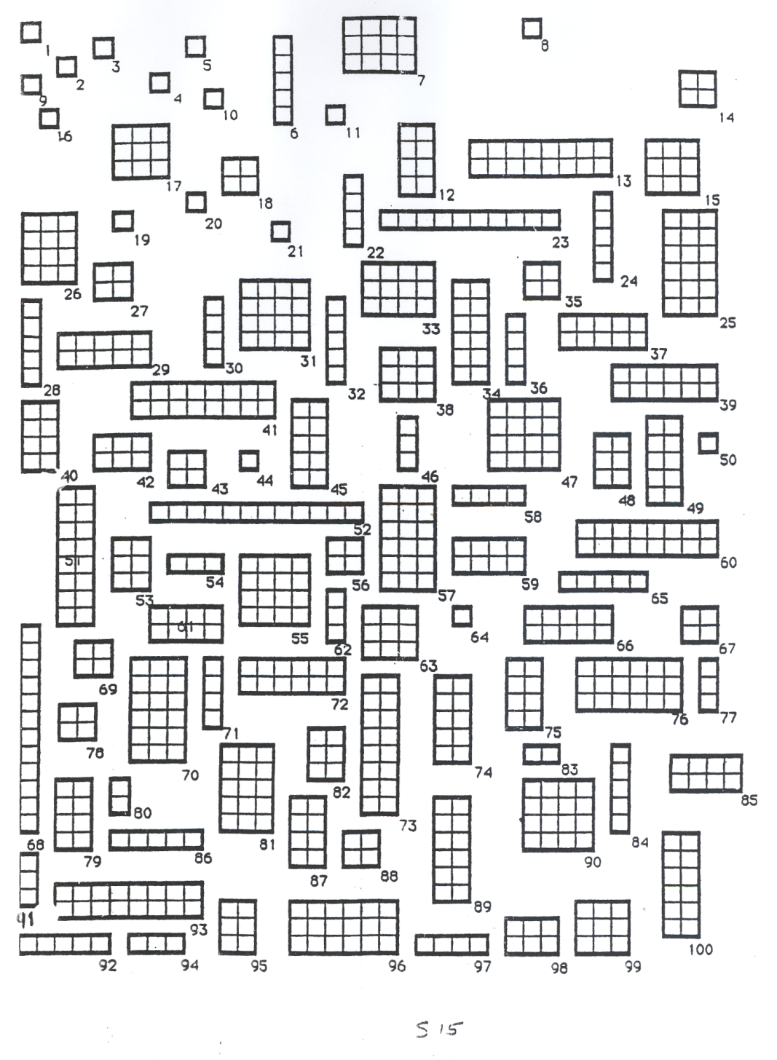

Slide 4
Explain to them: The rectangles represent 100 homes. The squares represent rooms in the house. There is no “right answer” to the task. Do not copy from you neighbor!! Ask the students to circle 5 “homes” to represent the community. Tell them to do this very quickly. They should count the number of rooms in each of the 5 houses. Then have them compute the mean and median number of “rooms” in the 5 houses.

Slide 5
Number of rooms for all 100 “homes”
Mean = 7.49
Median =6.0

Slide 6
When students choose the homes on their own, the majority choose homes that are larger (have more rooms) than average. Perhaps their eyes are attracted to these larger homes. Also many of the 1 room homes are bunched together in the upper left hand corner of the page. Then have them redo the problem with the students using random number tables to select a true random sample of 5 homes.

