Slide 1
Simpson's Paradox & Simpon’s 2nd Paradox
H. James Norton, William Anderson, Megan Templin Carolinas Medical Center, Charlotte, NC
George Divine, Henry Ford Hospital, Detroit MI
norton100@bellsouth.net
Website:
www.jimnortonphd.com

Slide 2
Paradox in published research goes back to at least the late 1800s
See “The Pirates of Penzance” by Gilbert & Sullivan(1879)

Slide 4
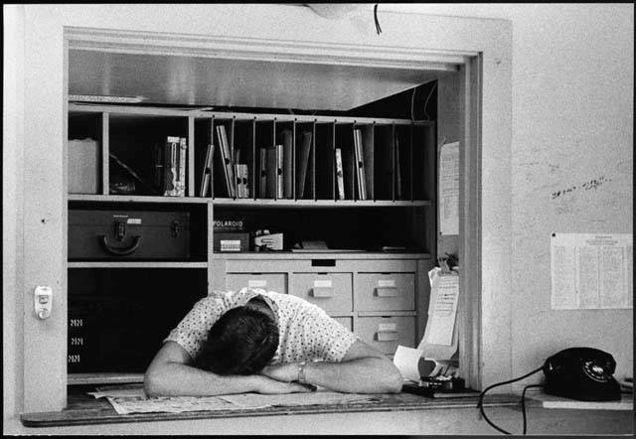
Keeping undergraduate biology students and medical residents interested in statistics, when the majority of the students are taking the class as a requirement, can be challenging

Slide 5
The following are examples of Simpson’s Paradox that you might find helpful in your course instruction.

Slide 6
Survival Rates
 | Died | Survived | Death Rate
Hospital A | 16 | 784 | 2.0%
Hospital B | 63 | 2037 | 3.0%
In which hospital would you want to have your surgery, A or B? Moore, D.S., McCabe, G.P., 1999, Introduction to the Practice of Statistics, 3rd edition: W. H. Freeman.

Slide 7
Patients in Good Condition
 | Died | Survived | Death Rate
Hospital C | 8 | 592 | 1.3%
Hospital D | 6 | 594 | 1.0%
If you are in good condition, in which hospital would you want to have your surgery, C or D? Moore, D.S., McCabe, G.P., 1999, Introduction to the Practice of Statistics, 3rd edition: W. H. Freeman.

Slide 8
Patients in Poor Condition
 | Died | Survived | Death Rate
Hospital C | 8 | 192 | 4.0%
Hospital D | 57 | 1443 | 3.8%
If you are in poor condition, in which hospital would you want to have your surgery, C or D? Moore, D.S., McCabe, G.P., 1999, Introduction to the Practice of Statistics, 3rd edition: W. H. Freeman.

Slide 9
Survival Rates
 | Died | Survived | Death Rate (%)
Hospital A | 16 | 784 | 2.0
Hospital B | 63 | 2037 | 3.0
Good Condition
Hospital C | 8 | 592 | 1.3
Hospital D | 6 | 594 | 1.0
Bad Condition
Hospital C | 8 | 192 | 4.0
Hospital D | 57 | 1443 | 3.8
Hospital A is the combined data for Hospital C, Hospital B is the combined data for Hospital D.

Slide 10
Simpson’s Paradox
Refers to the reversal of the direction of a comparison or an association when data from several groups are combined to form a single group.

Slide 11
Brief History of Simpson’s Paradox
Yule, GU, 1903, “Notes on the theory of association of attributes in Statistics”, Biometrika, 2: 121–134.
Cohen, MR, and Nagel, E, 1934, An Introduction to Logic and Scientific Method, New York: Harcourt, Brace and Co.
Simpson, EH, 1951, “The interpretation of interaction in contingency tables”, Journal of the Royal Statistical Society (Series B), 13: 238–241.
Blyth, CR, 1972, “On Simpson's Paradox and the Sure Thing Principle”, Journal of the American Statistical Association, 67: 364–366.
Bickel, PJ, Hjammel, EA, and O'Connell, JW, 1975, “Sex Bias in Graduate Admissions: Data From Berkeley”, Science, 187: 398–404.

Slide 12
Conditions when Simpson’s Paradox will not occur: Sample sizes are the same
 | Died | Survived | Death Rate (%)
Hospital A | 20 | 380 | 5.0
Hospital B | 132 | 2868 | 4.4
Good Condition
Hospital A | 12 | 188 | 6.0
Hospital B | 75 | 1425 | 5.0
Bad Condition
Hospital A | 8 | 192 | 4.0
Hospital B | 57 | 1443 | 3.8
# Hospital A Good Condition = # Hospital A Bad Condition = 200, # Hospital B Good Condition = # Hospital B Bad Condition = 1500

Slide 13
Conditions when Simpson’s Paradox will not occur: Rates are the same
 | Died | Survived | Death Rate (%)
Hospital C | 32 | 784 | 4.0
Hospital D | 95 | 2405 | 3.8
Good Condition
Hospital C | 24 | 576 | 4.0
Hospital D | 38 | 962 | 3.8
Bad Condition
Hospital C | 8 | 192 | 4.0
Hospital D | 57 | 1443 | 3.8

Slide 14
Examples of Simpson’s Paradox in the Literature
Study Type | Author | Dependent Variable | Independent Variable | Stratification Variable
Epidemiological | Cohen | death | location | race
Epidemiological | Morrell | medical aid | children (followed, not followed) | race
Epidemiological | Severijnen | urinary tract infection | antibiotic prophylaxis (y/n) | incidence of urinary tract infection
Legal | Bickel | admission | gender | department
Legal | Blume | death sentence | race of offender | race of victim
Medical | Charig | success removing kidney stones | open surgery or percutaneous | kidney stone diameter (<2cm)
Medical | Gatling | death | insulin dependent (y/n) | age (<40)
Psychological | Hand | percent male | year (1970/1975) | age (<65)

Slide 15
Severijnen AJ, Verbrugh HA, Mintjes-de Groot AJ, Vandenbroucke-Grauls CMJE, van Pelt W. Sentinel System for nosocomial Infections in the Netherlands: A Pilot Study. Infect Control Hosp Epidemiol 1997; 18:818–824.
Low incidence hospitals | UTI | No UTI | % with UTI
Antibiotic Prophylaxis | 20 | 1093 | 1.8
No Antibiotic Prophylaxis | 5 | 715 | 0.7
High incidence hospitals
Antibiotic Prophylaxis | 22 | 144 | 13.3
No Antibiotic Prophylaxis | 99 | 1421 | 6.5
Combined
Antibiotic Prophylaxis | 42 | 1237 | 3.3
No Antibiotic Prophylaxis | 104 | 2136 | 4.6

Slide 16
C. Morrell, Mathematical Science Department, Loyola College, Baltimore, MD
Caucasians | Medical Aid | No Medical Aid | Rate of Medical Aid (%)
Children not traced | 104 | 22 | 82.5
Five-year group | 10 | 2 | 83.3
African Americans
Children not traced | 91 | 957 | 8.7
Five-year group | 36 | 368 | 8.9
Combined
Children not traced | 195 | 979 | 16.6
Five-year group | 46 | 370 | 11.1

Slide 17
Hand DJ. Psychiatric examples of Simpson's paradox. Br J Psychiat 1979;135: 90–1.
Age < 65 | Male | Female | Percent Male
Year 1970 | 255 | 174 | 59.4
Year 1975 | 156 | 102 | 60.5
Age >/= 65
Year 1970 | 88 | 222 | 28.4
Year 1975 | 82 | 175 | 31.9
Combined
Year 1970 | 343 | 396 | 46.4
Year 1975 | 238 | 277 | 46.2

Slide 18
Cohen, M. R., and Nagel, E., 1934, An Introduction to Logic and Scientific Method, New York: Harcourt, Brace and Co. Death Rates from Tuberculosis in Richmond and New York City in 1910
Caucasians | Died | Survived | Death Rate per 100,000 (%)
New York | 8,365 | 4,666,809 | 178.9
Richmond | 131 | 80,764 | 161.9
African Americans
New York | 513 | 91,196 | 559.4
Richmond | 155 | 46,578 | 331.7
Combined
New York | 8,878 | 4,758,005 | 186.2
Richmond | 286 | 127,342 | 224.1

Slide 19
Charig, C.R., Webb, D.R., Payne, S.R., Wickham, J.E. "Comparison of treatment of renal calculi by open surgery, percutaneous nephrolithotomy, and extracorporeal shockwave lithotripsy. Br Med J (Clin Res Ed) 292 (6524): 879–882.
Kidney stones < 2cm | success | failure | % successful
Open | 81 | 6 | 93
Percutaneous | 234 | 36 | 87
Kidney stones >= 2cm
Open | 192 | 71 | 73
Percutaneous | 55 | 25 | 69
Combined
Open | 273 | 77 | 78
Percutaneous | 289 | 61 | 83

Slide 20
Gatling W, Mullee MA, Hill RD. The general characteristics of a community based population. Practical Diabetes 1989; 5:104-7.
Patients age <= 40 | Died | Alive | % Died
Insulin Dependent | 1 | 129 | 0.8
Non-Insulin Dependent | 0 | 15 | 0.0
Patients age > 40
Insulin Dependent | 104 | 124 | 45.6
Non-Insulin Dependent | 218 | 311 | 41.2
Combined
Insulin Dependent | 105 | 253 | 29.3
Non-Insulin Dependent | 218 | 326 | 40.1

Slide 21
Blume JH, Eisenberg T, Wells MT; Explaining Death Row’s Population & Racial Composition;
Scholarship@Cornell: A Digital Repository;3/1/2004.
Indiana Death Sentence Rate
Black victim | Murders | # of death sentences | Death sentence rate
Black offender | 2,151 | 12 | 5.6
White offender | 100 | 0 | 0
White victim
Black offender | 375 | 16 | 42.7
White offender | 2,272 | 49 | 21.6
Combined
Black offender | 2,526 | 28 | 11.1
White offender | 2,372 | 49 | 20.7

Slide 22
Bickel, PJ, Hammel, EA and O’Connell, JW. Sex Bias in Graduate Admissions: Data from Berkeley. Science 1975; 187: 398-403.
Overall | Admitted | Applicants | Admittance Rate(%)
Men | 3715 | 8442 | 44
Women | 1513 | 4321 | 35
Department A
Men | 512 | 825 | 62
Women | 89 | 108 | 82
Department B
Men | 353 | 560 | 63
Women | 17 | 25 | 68

Slide 23
Bickel, PJ, Hammel, EA and O’Connell, JW. Sex Bias in Graduate Admissions: Data from Berkeley. Science 1975; 187: 398-403.
Overall | Admitted | Applicants | Admittance Rate(%)
Men | 3715 | 8442 | 44
Women | 1513 | 4321 | 35
Department C
Men | 121 | 325 | 37
Women | 202 | 593 | 34
Department D
Men | 138 | 417 | 33
Women | 132 | 375 | 35

Slide 24
Bickel, PJ, Hammel, EA and O’Connell, JW. Sex Bias in Graduate Admissions: Data from Berkeley. Science 1975; 187: 398-403.
Overall | Admitted | Applicants | Admittance Rate(%)
Men | 3715 | 8442 | 44
Women | 1513 | 4321 | 35
Department E
Men | 54 | 191 | 28
Women | 95 | 393 | 24
Department F
Men | 17 | 272 | 6
Women | 24 | 341 | 7

Slide 25
Which statistical methods will “Lift the curtain of illusion to let the truth of my soul shine through*” regarding Simpson’s Paradox?
Stratification
Standardization
Logistic regression
* By Trudy Symeonakis Vesotksy

Slide 26
Definition of confounding
Confounding/distortion can arise when two conditions are true:
The risk groups differ on the background factor/variable
The background factor/variable itself influences the outcome
If you do not control for confounding, the unadjusted variables can be distorted/misleading
Simpson’s Paradox is caused by confounding
Anderson S, Auquier A, Hauck WW, Oakes D, Vandaele W, Weisberg, HI; 1980;
Statistical Methods For Comparative Studies: Techniques For Bias Reduction;
John Wiley & Sons; New York.

Slide 27
Beware the Lurking Variable:
Understanding Confounding from Lurking Variables Using Graphs;
Schield, Milo;
STATS, Fall 2006, #46,14-18.
The data below are an example of Simpson’s Paradox.

Slide 28
The combined overall death rate of 3.5% for the rural hospital versus 5.5% for the urban hospital is not a fair comparison as 30% of the rural hospital’s patients are in poor condition while 90% or the urban hospital’s patients are in poor condition.
Let’s standardize the rates to make it a fair comparison. The standard population will consist of all the patients from both hospitals. The combined population consists of 800 patients in good condition and 1200 patients in poor condition (40% vs. 60%).
The standardized death rate for the rural hospital would be
(.02 X .40 + .07 x .60) = .008 + .042 = .05 = 5%.
The standardized death rate for the urban hospital would be
(.01 X .40 + .06 x .60) = .004 + .036 = .04 = 4%.
With the death rates standardized, we see that the urban hospital has a lower death rate of 4% vs. 5% for the rural hospital!
Dr. Schield then provides us with a graphic presentation.

Slide 29
Graphic Presentation of Simpson’s Paradox
Let SRR = standardized rate rural, SRC = standardized rate city
P= proportion of patients in poor condition in a standard population.
SRR=(.07 X P) + .02 x (1 –P)= (.07-.02)P + .02 = .02 + (.05 x P)
SRC=(.06 X P) + .01 x (1 –P)= (.06-.01)P + .01 = .01 + (.05 x P)

Slide 30
SAS code for logistic regression using Dr. Schield’s data.
data simpsonsparadox;
input condition hospital death numcell ;
cards;
0 0 0 99
0 0 1 1
0 1 0 686
0 1 1 14
1 0 0 846
1 0 1 54
1 1 0 279
1 1 1 21
;
run;
proc logistic data=simpsonsparadox descending;
class condition hospital death / param=ref;
model death=hospital condition; weight numcell;
format condition condition. hospital hospital. death death.;
title 'Data from Dr. Schield analyzed using logistic regression –
Probability modeled is death = yes';
run;

Slide 31
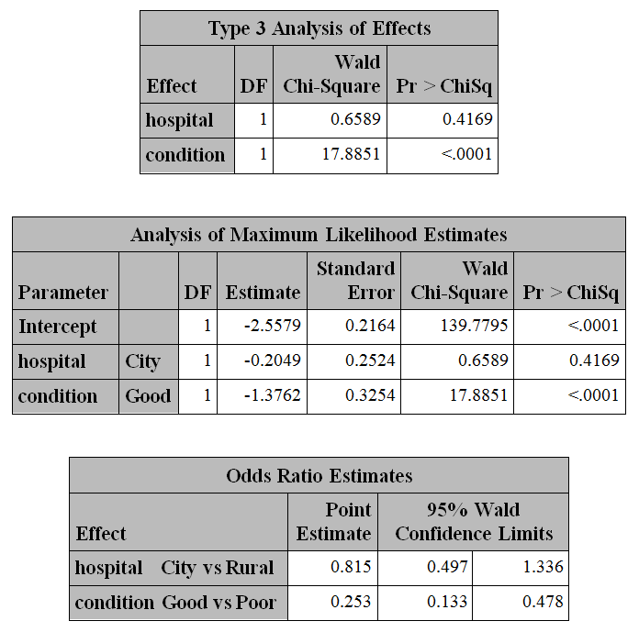
Data from Dr. Schield analyzed using logistic regression

Slide 32
Simpson’s 2nd Paradox
Whether “the sensible interpretation” exists in the separate tables, or is instead found in the combined table, depends upon the context of the data being analyzed. This means that the correct interpretation cannot be reliably determined merely by looking at the numbers in the table.
Suppose (hypothetical) data are analyzed to determine whether a new treatment (A) is superior to the standard treatment (B) for septic shock.

Slide 33
Success of treatment for septic shock by diastolic blood pressure
Combined | Alive | Dead | % alive
Treatment A | 860 | 140 | 86
Treatment B | 700 | 300 | 70
DBP < 50
Treatment A | 50 | 50 | 50
Treatment B | 250 | 250 | 50
DBP ≥ 50
Treatment A | 810 | 90 | 90
Treatment B | 450 | 50 | 90

Slide 34
In the previous examples, a sensible interpretation has been found in the separate tables. Could it be that the separate tables are not showing the complete story for this situation? Suppose the facts regarding the data are:
2000 patients thought to have septic shock are randomized equally to Treatment A or Treatment B.
The 2 groups have identical DBP distributions upon arrival at the Emergency Department.
All patients survive the 1st day.
DBP is measured at the end of 24 hours of treatment and the DBP in the table is based upon this 2nd measurement.
Only one tenth (100/1000) of the Treatment A patients crash below 50.
One half (500/1000) of the Treatment B patients crash below 50.
The biology of the situation would suggest that the sensible interpretation is found in the combined table.
Note that DBP was not a variable that was fixed at the start of the experiment but was an intermediate outcome affected by the treatment.
If the variable is only on the causal pathway, it is not a confounder variable and you should not adjust for it.

Slide 35
Conclusions:
Hopefully, the use of Simpson's Paradox will improve the learning experience for the students.

Slide 36
Facts are stubborn but statistics are more pliable.

Slide 37
There are 2 kinds of statistics- the kind you look up & the kind you make up.

Slide 38
Aaron Levenstein “Statistics are like a bikini. What they reveal is suggestive, But what they conceal is vital.”

Slide 39
Statistics can be used to support just about anything...

Slide 40
including statisticians!!

Slide 41
